Slide 1
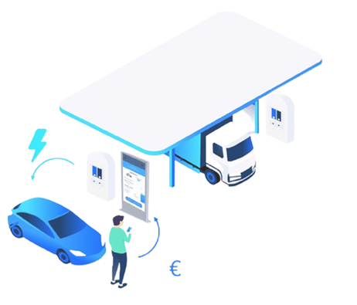

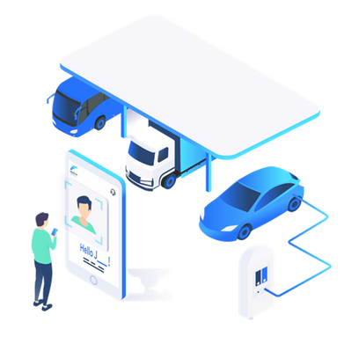
FillnDrive

Slide 2

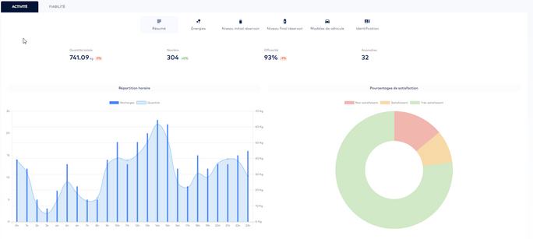
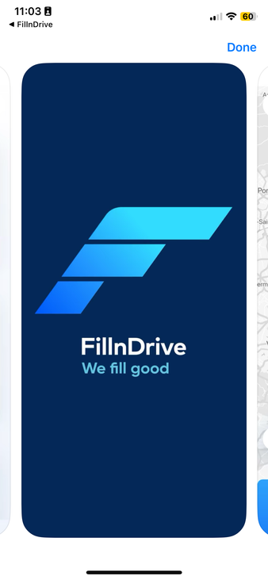
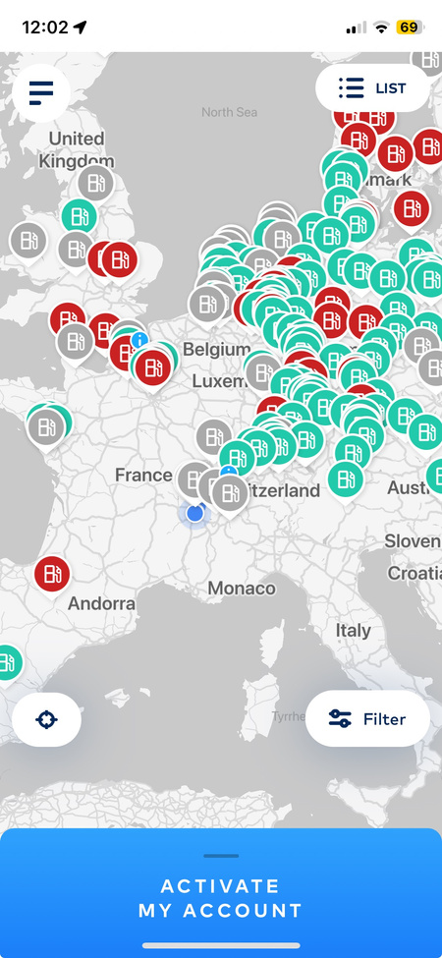
FillnDrive, a Triptic solution
1.WebPortal
2. Mobile App
3.Hardware
  Station operations management
  Account customers
  Pricing and billing
  Account customer portal
  API (FMS/ERP)
  Payment solution option
  (Visa & Mastercard)
  Live stations availability at product level
  User profil with historic
  Configurable Display
  Multilingual HMI & audio messages
  User Guide
  Specific Hydrogen data
DATA /INFORMATION
ACCESSIBILITY
USER EXPERIENCE

Slide 3
FillnDrive, a Triptic solution
1.WebPortal
3.Hardware
Back Office Users
  Dispenser Manufacturers
  Hydrogen Suppliers
  Mobility service providers
  Vehicle OEM
  Station Operator
  Fleet Manager
  Station operations management
  Account customers
  Pricing and billing
  Account customer portal
  API (FMS/ERP)
Back Office Features
  Configurable Display
  Multilingual HMI & audio messages
  User Guide
  Specific Hydrogen data
  Station operations management
  Account customers
  Pricing and billing
  Account customer portal
  API (FMS/ERP)
  H2map real time data transfer
DATA /INFORMATION
USER EXPERIENCE

Slide 4
FillnDrive, a Triptic solution
1.WebPortal
2. Mobile App
3.Hardware
  Station operations management
  Account customers
  Pricing and billing
  Account customer portal
  API (FMS/ERP)
  Payment solution option
(Visa & Mastercard)
  Live stations availability at product level
  User profil with historic
  Configurable Display
  Multilingual HMI & audio messages
  User Guide
  Specific Hydrogen data
DATA /INFORMATION
ACCESSIBILITY
USER EXPERIENCE

Slide 5


FillnDrive, a Triptic solution
1.WebPortal
2. Mobile App
3. Local Support
FillnDrive Mobile App
  Payment solution option
(bank card)
  Live stations availabilities
  User profil with historic
DOWNLOAD THE APP >
  Station operations management
  Account customers
  Pricing and billing
  Account customer portal
  API (FMS/ERP)
  Payment solution option (Visa & Mastercard)
  Live stations availability at product level
  User profil with historic
  Refueling list,
  System configuration: Product price, VAT rate, Products, Languages …
  Regulatory visit management features
Version Apple
Version Android
DATA /INFORMATION
ACCESSIBILITY
ASSISTANCE

Slide 6
FillnDrive, a Triptic solution
1.WebPortal
2. Mobile App
3.Hardware
  Station operations management
  Account customers
  Pricing and billing
  Account customer portal
  API (FMS/ERP)
  Payment solution option (Visa & Mastercard)
  Live stations availability at product level
  User profil with historic
  Configurable Display
  Multilingual HMI & audio messages
  User Guide
  Specific Hydrogen data
DATA /INFORMATION
ACCESSIBILITY
USER EXPERIENCE

Slide 7
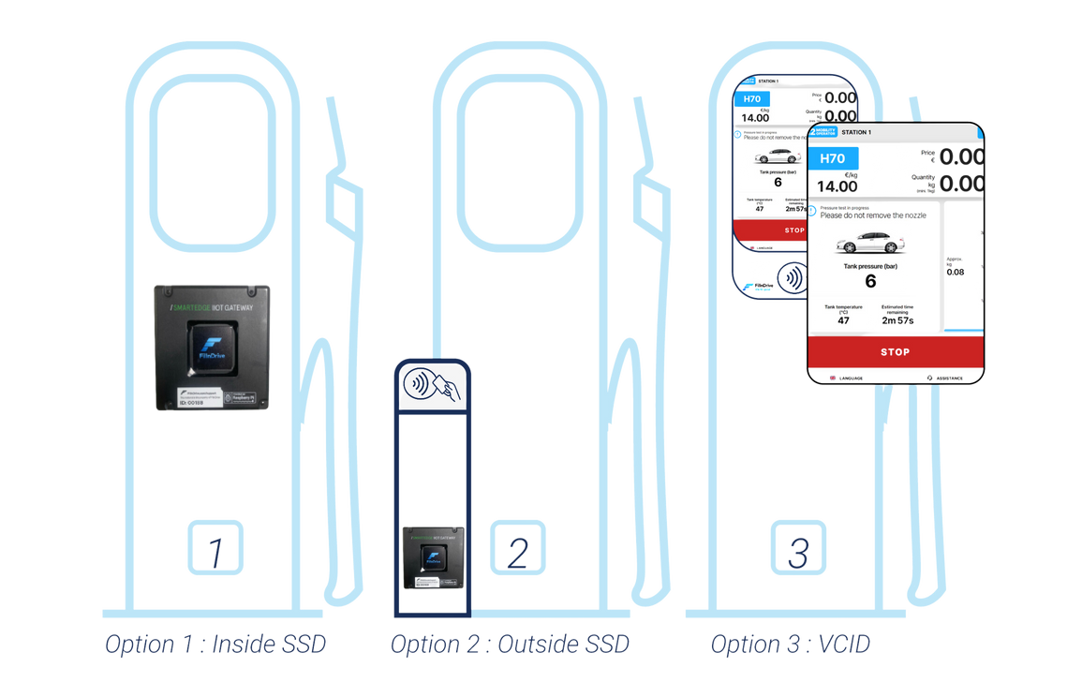
FillnDrive, a Triptic solution
1.WebPortal
2. Mobile App
3. Hardware
Friendly User Experience
  Audio/ Vidéo Guide and Assistance
  Easy identification solution (NFC/Bluetooth)
  Multiple payment solutions
  Station operations management
  Account customers
  Pricing and billing
  Account customer portal
  API (FMS/ERP)
  Payement solution option (via Stipe)
  Live stations disponnibilities
  User profil with historic
  Configurable Display
  Multilingual HMI & audio messages
  User Guide
  Specific Hydrogen data
Payement Methods
  Integrated bank card reader
  Bank card Output Terminal/at the Shop (LON/IFSF)
  Mobile App Payment
  Private Fleets refueling cards
  FillnDrive H2 card
DATA /INFORMATION
ACCESSIBILITY
USER EXPERIENCE

Slide 8


V.C.I.D
User interface, Legal metrology
and Payment solutions
for Hydrogen Dispensers

Slide 9

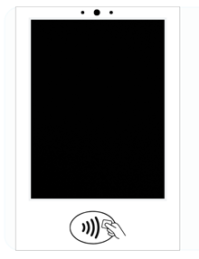
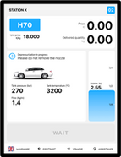


VCID at a glance/ in a nutshell
FillnDrive is proud to provide VCID to your Dispenser
VCID is a smart and connected device offering:
  Legal metrology features
  Cutting-edge User interface
  Payment solutions
Micro and loudspeaker, with multilanguage audio messages
Calculator and indicating device area (OIML R139)
15" touchscreen
NFC and Bluetooth readers
Features are provided to :
  Driver/customer
  Operators team
  Manufacturers maintenance team
  Legal Controllers
Certification according to MID 2014/32/EU and OIML recommendation n°139 is expected in dec 2023.

Slide 10
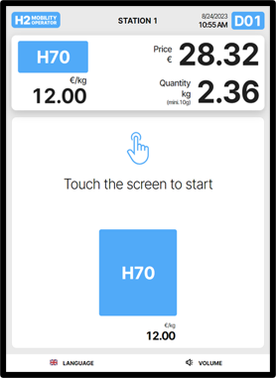
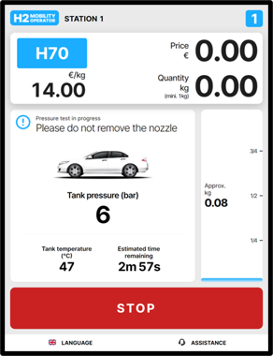
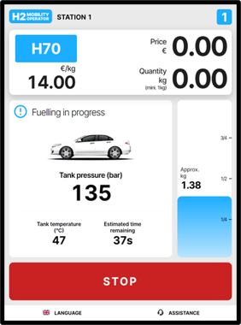
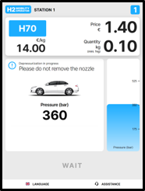
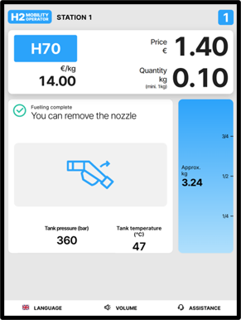
User Interface for Vehicle Drivers
  Cutting-edge interactive User Interface
  Detailed video as User Guide
  Various European languages available
  Audio messages
  Direct audio assistance
  Fully suitable to the dispenser specificities
Example of the driver’s customer journey

Slide 11

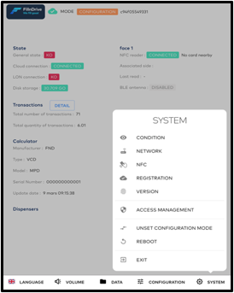

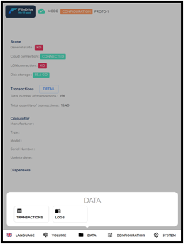
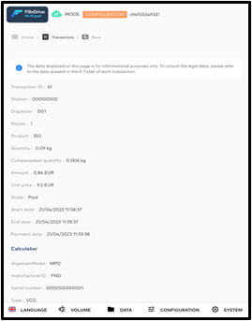
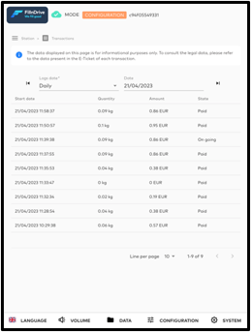
Operator easily accesses to dedicated features
Operator
Technicians
Direct info on the VCID :
  Refueling list,
  System configuration: Product price, VAT rate, Products, Languages …
  Logs list
  Regulatory visit management features
FillnDrive NFC card
VCID screens dedicated to Technicians

Slide 12


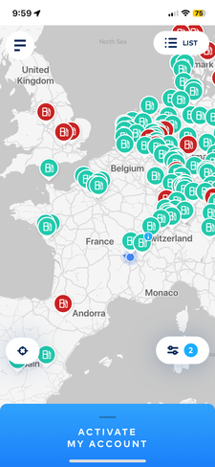
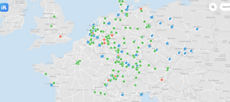
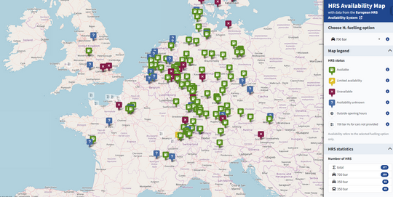
Dispenser connected to the Hydrogen World
Manufacturer operation team
Operator
team
  Direct audio assistance
  Remote operation and configuration management (Web portal )
  Availability Status automatically transferred to H2map.eu, H2live app, FillnDrive Mobile App
VCID Easy Configuration Management Module
Easy Station Operation Module
WEB PORTAL
H2Live
(app + website)
Drivers
H2map.eu
FillnDrive App
Real-time Availability Data Transfer
Connected Station

Slide 13
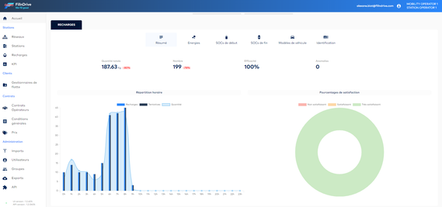
Includes Operator access to Webportal features
Available for the Station Operator after a FREE activation
Operator
(back office)
Features :
  Refueling list
  Refueling statistics (per day, per week, per month, per station, per dispenser …)
  Manage local price, VAT rate,
  Manage the technicians’ NFC Cards
  Direct audio interaction to assist drivers
  Change the station’s public status
  Live refueling visualisation data
  Remote refueling authorization
FillnDrive Web Portal
Easy Station Operation Module

Slide 14
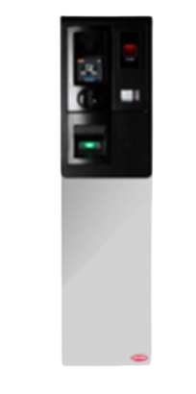
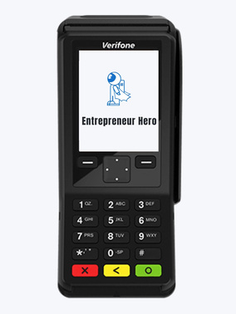
Multiple Payment Capabilities
VCID Dispensers accept several means of payment, according to Operator needs, and customer targets.
Several Means of payment can be jointly used at the dispenser
Physical Solutions
A
C
Integrated bank card reader
Mobile App Payment
Bank card reader proposed by FillnDrive, thanks to a strategic supply agreement
Bank cardpayment via the FillnDrive Mobile Application (open to all) with Bluetooth
C
B
D
D
Output Terminal/ at the Shop
Private fleets refueling card
Card reader connected to the VCID via IFSF/LON (Bank Card + Fuel/fleet Card)
Private Cards for registered fleet customer (Operator branding)
E
A
B
E
FillnDrive H2 Card
100 000+ transactions in 2023
1000 + card holders
15 Station network operators
LON Cable
IFSF Protocol
Join the FillnDrive ecosystem (data, collaborative services, improve the driver UX even more)
Dispenser with a FillnDrive VCID
OutPut Payment
Terminal

Slide 15
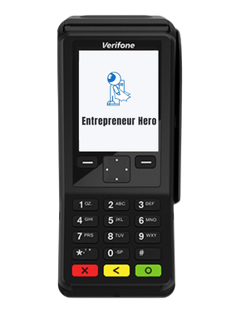
Payment means for Public Stations
Physical Solutions
A
Integrated bank card reader
Bank card reader proposed by FillnDrive, thanks to a strategic supply agreement
C
B
Output Terminal/ at the Shop
Card reader connected to the VCID via IFSF/LON (Bank Card + Fuel/fleet Card)
A
B
C
LON Cable
IFSF Protocol
Mobile App Payment
Bank cardpayment via the FillnDrive Mobile Application (open to all) with Bluetooth
Dispenser with a FillnDrive VCID
OutPut Payment
Terminal

Slide 16
Selling models
Dispenser manufacturer subscription
Operator subscription
A
C
VCID Easy Configuration Management Module
Mobile App Payment
Bank cardpayment via the FillnDrive Mobile Application (open to all) with Bluetooth
For Dispenser Manufacturer
B
D
VCID Easy Configuration Management Module
Private fleets refueling card
Private Cards for registered fleet customer (Operator branding)
For Station Operator
Free activation for operator, upon request
E
FillnDrive H2 Card
Join the FillnDrive ecosystem (data, collaborative services, improve the driver UX even more)
Dispenser with a FillnDrive VCID

Slide 17
Selling models
Dispenser manufacturer subscription
Operator subscription
A
C
VCID Easy Configuration Management Module
Mobile App Payment
Bank cardpayment via the FillnDrive Mobile Application (open to all) with Bluetooth
For Dispenser Manufacturer
B
E
VCID Easy Configuration Management Module
FillnDrive H2 Card
Join the FillnDrive ecosystem (data, collaborative services, improve the driver UX even more)
For Station Operator
Free activation for operator, upon request
D
Private fleets refueling card
  Includes 50 branded NFC tag
  No mobile app
  Access control/odometer capture option
  Remote stock
  No customer webportal
  No roaming
Private Cards for registered fleet customer (Operator branding)
Dispenser with a FillnDrive VCID

Slide 18
A - Integrated bankcard reader
A
Integrated bankcard reader
Bank card reader proposed by FillnDrive, thanks to a strategic supply agreement with WorldLine
This is an accessory proposed by FillnDrive, to be ordered by the Dispenser Manufacturer and mounted in dispensers for which the operator has chosen this means of payment.
  Order a solution with POS / EPT from the manufacturer
  Creation with FillnDrive of the Worldline file
Price :
  Transaction fee : charged by Worldline
  Operator Opex: Subscription to FillnDrive -> Physical bank card payment module
  Capex: Price of equipment
Step 1
  Delivery of VCID and implemented card reader from the manufacturer
Step 2
  Complete VCID configuration file and FillnDrive operator account in the platform
  Commissioning of the solution for the operator with Fillndrive
Step 3

Slide 19
B - Output Payment Terminal / At the shop
B
Output Payment Terminal or payment at the shop
Vendor Equipment to beconnected to VCID via LON cable and using IFSF protocol
Solution for Operators that have already implemented such equipment, connected via Vendor Cloud to their Info System.
Payment goes to the operator’s bank account from the customer’s bank account with no FillnDrive interaction.
  Operator or Dispenser Manufacturer order a VCID accessory (LONCOM)
Price :
  Capex to FillnDrive: LONCOM accessory
  Other costs: To be handled between operator and POS Vendor
Step 1
  The operator is responsible for setting up the payment system
Step 2
  All bank and payment implementations are to be handled bilaterally by the operator with the Vendor of the selected payment device (OPT)
Vendor OPT
System
Operator
System
Step 3
Vendor OPT

Slide 20
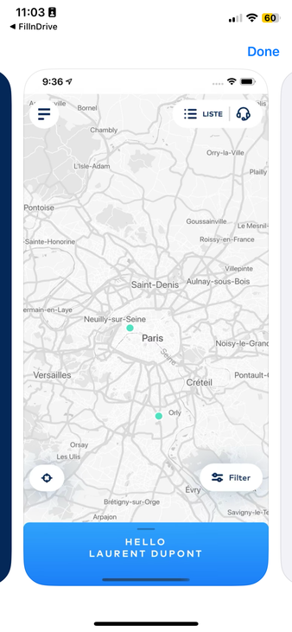
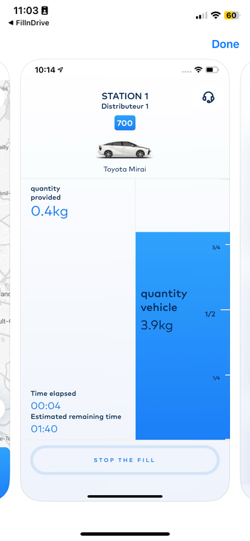
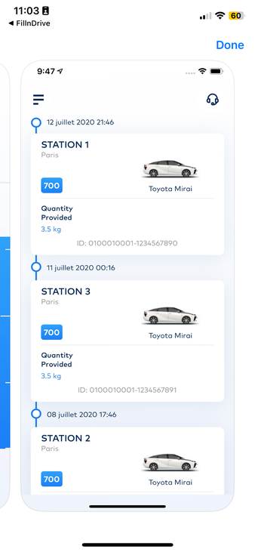
C - FillnDrive Mobile App bankcard payment
C
FillnDrive Mobile Application bank card payment
Bank cardpayment via the FillnDrive Mobile Application (open to all) with Bluetooth. No additional hardware required.
Features
  Operator may opt for accepting dematerialized bank card payment, proposed by the FillnDrive Mobile Applications (IOS/Android)
  Dedicated to public/anonymous customer
  The customer has to create an account in the FillnDrive Mobile Apps, to store its payment info and his refueling history and statistics
  The price per kg of hydrogen is the one displayed at the station
Price :
  Opex : FillnDrive subscription + Stripe transaction fee
  Capex for FillnDrive: Commissioning / no additional hardware costs

Slide 21
D - FillnDrive Private fleets refueling card
C
FillnDrive Mobile Application bank card payment
Bank cardpayment via the FillnDrive Mobile Application (open to all) with Bluetooth. No additional hardware required.
Features
  Operator manages numerous fleet customer accounts and provides customers with NFC cards/tags for identification at its stations.
  Each NFC card/tag can be associated to either a driver (firstname/lastname) or a vehicle (plate or VIN)
  Drivers can consult their refueling history and related statistics in the FilllnDrive Mobile App they also use to check the availability of each station in real-time.
  Numerous KPIs on the refueling activity : per customer accounts, per vehicles fleets, per driver, per vehicle, per dispenser, per product …
  Notification about events maintenance operations can be sent to fleet managers and/or drivers via emails or Mobile App pop-up notifications.
  Operator can export transactions and refueling lists in a CSV file to be used or imported afterward into a dedicated software system for invoicing and accounting.
In option :
  FillnDrive proposes a Pricing & Billing Module, allow the operator to create Private pricing term and conditions can be defined, per customer fleet, per product (H70, H35HF, etc), per station
  Fleet manager, as operator’s customers can access to their own environment on the FillnDrive webPortal, to consult refueling data, and statistics, manage drivers NFC Cards, export data, download operator’s invoices.
Price :
  Opex : SaaS subscription
  Capex : configuration & branded NFC badges

Slide 22
E - FillnDrive H2 Card
C
FillnDrive H2 Card
Private Cards for registered fleet customer (Operator branding)
Features
  Used by more than 15 Hydrogen Station operators in Europe
  1000+ cardholders
  Give them access to your Dispenser, with no additional hardware
  Post-payment by their Operator at public price
100 000+ transactions in 2023
1000 + cardholders
15 Station network operators
Fleet Drives
B
Fleet Drives
A
FillnDrive H2 Card
NFC
Operator A NFC Cards
FillnDrive H2 Card
Operator A Station
Classic Identification
Contact FillnDrive

